Slide 1
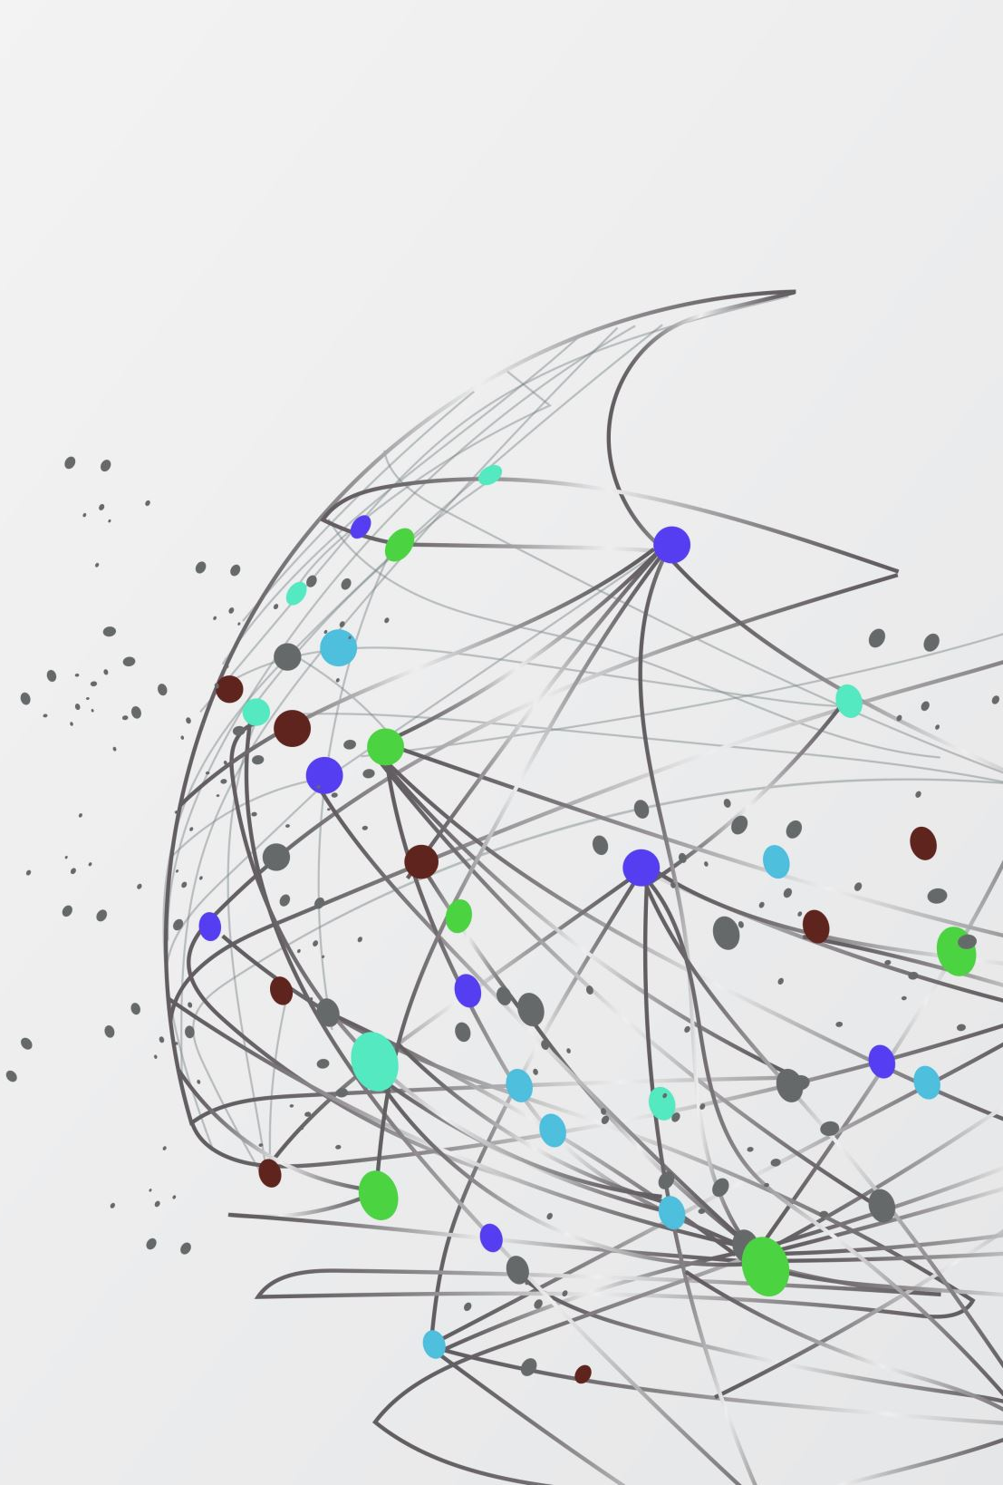

MACHINE LEARNING PROJECT
-BY SAI ROHAN PARITALA

Slide 2
OBJECTIVE
This project aims to understand the Fetal cardiology medical dataset using the classification Decision Tree under the Machine Learning algorithm.

Slide 3
Data Description
· BPM (Beat per minute).
· APC (Accelerations per second)
· FMPS (Fetal movement per second)
· UCPS (Uterine contractions per second)
· DLPS (Light declaration per second)
· SDPS (Severe declaration per second)
· PDPS (Prolonged declaration per second)
· ASTV (% of abnormal short term Variability)
· MSTV (Mean of short term Variability)
· ALTV (% of abnormal long term Variability)
· MLTV (Mean of long term Variability)
· Width (Width of FHR Histogram)
· Min (Min Width of FHR Histogram)
· Max (Max Width of FHR Histogram)
· NSP (Fetal State Class codeN=normal (1); S=Suspect (2); P=Pathologic (3))

Slide 4
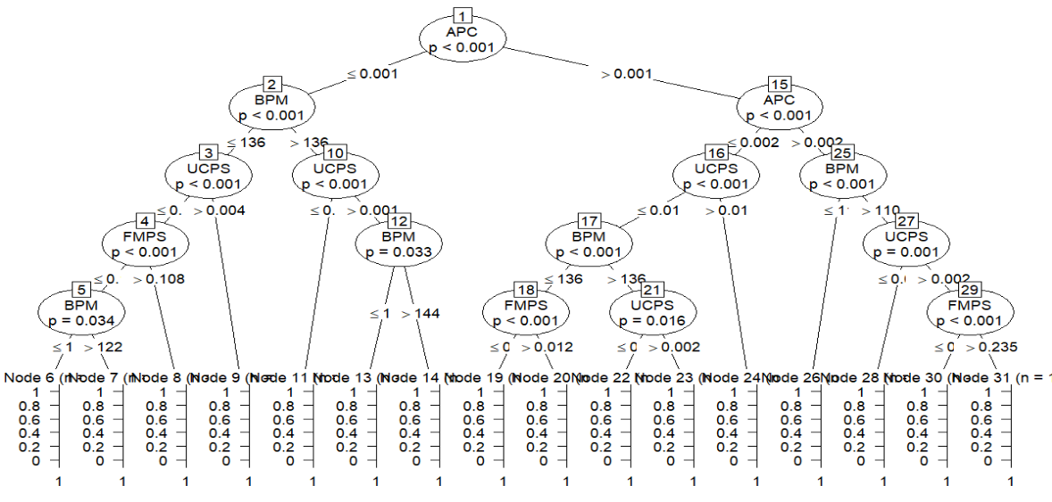

Approach

Slide 5
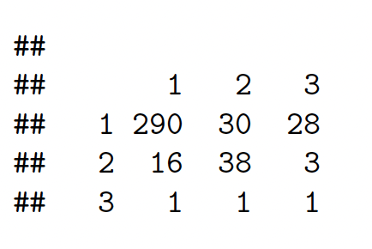

Result
N= Normal(1);
S= Suspect (2);
P=Pathologic (3)
Accuracy of the model

